Slide 1
Node JS

Slide 2
Node.js is a JavaScript runtime to build fast, scalable network applications.
It helps us to use JavaScript in server-side coding.
JavaScript is responsible for most of the client-side processing in web applications today.

Slide 3
Need of Node.js
Let us look at the below scenarios for understanding the need for Node.js:
Scenario 1: JavaScript has been the most used language for creating dynamic web pages. JavaScript has moved to the server-side too, establishing itself on the web servers as well.
Node.js also represents the "JavaScript everywhere" paradigm, by unifying web application development around a single language, rather than using different languages for server-side and client-side.

Slide 4
Scenario 2: Consider a scenario where you are trying to upload videos to a social media website. You may observe that lot of time is taken for getting your request processed.
This may be because the preceding requests need to be completed first by the web server of the application before executing this new request.
In order to ensure the requests get served concurrently, multiple approaches have been proposed. This is where Node.js comes in.

Slide 5
Since Node.js uses an event looping mechanism, a Node.js web server is capable of sending responses in a non-blocking way.
This eventually means, a Node.js server can handle a large number of requests than the commonly used traditional web servers.

Slide 6
Node.js and its Benefits
1. Node is popular: Node.js uses JavaScript for application development. JavaScript is a powerful programming language as it provides good flexibility to developers.
2. Full-stack JavaScript development: Node.js has paved the way for JavaScript to be on the server-side as well. Hence applications can now have both back-end and front-end developed with the same JavaScript language. We now have two popular JavaScript software stacks for building full-stack web applications: MEAN and MERN.

Slide 7
Node is the N in the MEAN stack. In this stack, Node is used along with the MongoDB database and Express, which is a Node framework for back-end application development.
Angular framework is used for front-end application development.
Node is the N in the MERN stack as well. Here, Node is used along with MongoDB database and Express for back-end application development.
React is used for front-end application development in this stack.

Slide 8
3. Very fast: Node applications have better performance than applications developed using other technologies due to the JavaScript engine used internally in Node. The engine converts JavaScript code into machine code and provides extremely fast execution.
4. Node is powerful: Node uses a non-blocking I/O model and asynchronous programming paradigm, which helps in processing requests in a non-blocking way.
5. Data Streaming: Node has a built-in Streams API that helps in creating applications where data streaming(reading and writing) is required.

Slide 9
6. Rich Ecosystem: Node.js provides a package manager called NPM (Node Package Manager) which is the world's largest software registry that helps open source developers to share and use packages using NPM.
7. Modularity: Node applications can be developed as modules which helps in dividing the application into a reusable set of code.
8. Wide client-side and database connectivity: Node.js has absolutely no dependencies and also goes perfectly with any possible client-side technologies like Angular, React, etc., and any database like MySQL or MongoDB.

Slide 10
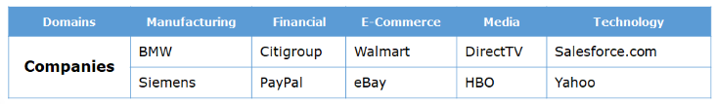
Organizations using Node.js
Node.js is used in applications developed for a wide range of domains.
All these organizations were using different technologies like Java, Rails, etc. for developing the server-side of their applications. But later, they migrated to Node.js because of the features provided by it.

Slide 11
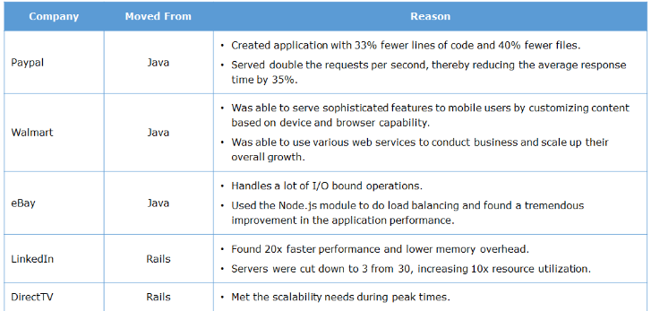
The below table lists the reasons why they migrated to Node.js.

Slide 12
What is Node.js?
Node.js is an open-source JavaScript run-time environment used for building scalable network applications.
It helps in developing the server-side of the application using JavaScript language. It is used for building data-intensive real-time applications.
What can we build using Node.js? 1. Complex SPA(Single Page Applications) 2. Real-time applications like Chat rooms 3. Data streaming applications 4. REST APIs 5. Server-side web applications

Slide 13
Features of Node.js
1. V8 engine
As application development in Node uses JavaScript language, the Node.js platform needs an engine for executing JavaScript.
The engine used in the platform is V8 which is an open-source high-performance engine.
It is developed by Google and written in C++.
V8 compiles JavaScript source code into native machine code.
The performance of the Node.js application is faster due to this ultra-fast engine used in the platform.

Slide 14
2. Single codebase
Since coding in Node is based on JavaScript, both the client and the server-side code can be written using the same JavaScript language.
It allows the front-end and back-end teams to be combined into a single unit.
Also since Node.js uses JavaScript, we can quickly manipulate the JSON data retrieved from external web API sources like MongoDB, hence reducing the processing time needed per request.

Slide 15
3. Asynchronous and event-driven
All the APIs in Node are asynchronous i.e. non-blocking, which means Node-based server will never wait for an API to return data or to complete the request, it will move to the next request process.
The notification mechanism of Node.js helps in getting the response from the previous requests after its completion.
Executing JavaScript code can happen in a Synchronous or Asynchronous way.

Slide 16
Synchronous programming
In Synchronous programming, the code execution happens synchronously. This allows only one task to execute at a time.
Suppose, we need to read the content of a file and then database operation is to be executed. When the file read operation is started, the rest of the code in the program gets blocked until the file reading operation is finished. Once the file reading is done, then it continues to execute the remaining code. Though the database operation code is not dependent on the file read operation, it is getting blocked. This kind of code is considered as blocking code or synchronous code.

Slide 17
Asynchronous programming
The asynchronous code will get executed without affecting other code execution. This allows multiple tasks to happen at the same time.
Consider the same scenario of reading a file and then database operation is to be executed.
On asynchronously implementing this, when the file read operation is started, it will not wait for the read operation to complete, it will just continue execution of the rest of the code.
Once the file reading is done, it will be informed and the corresponding function gets called. This provides a non-blocking way of executing the code.
This improves system efficiency and throughput.

Slide 18
In Node.js, asynchronous programming is implemented using the callback functions.
Callback function: A callback is a function passed as an argument to another function and it will be executed after the task gets completed. It helps in non-blocking code execution.
setTimeout(() => {
console.log("after 20 seconds");
}, 20000);
setTimeout() takes two arguments. The first argument is the callback function and the second argument is the delay in milliseconds. The callback function is called after 20 seconds.
In Node.js, at the completion of each task, the respective callbacks written gets invoked. This makes Node.js highly scalable as it can handle a large number of requests in a non-blocking way.

Slide 19
4. Single-threaded event loop model
Node.js is said to be highly scalable because it handles the client request using the Single-threaded model with an event loop. Node environment follows the Single Threaded Event Loop Model which is based on JavaScript's callback mechanism.

Slide 20
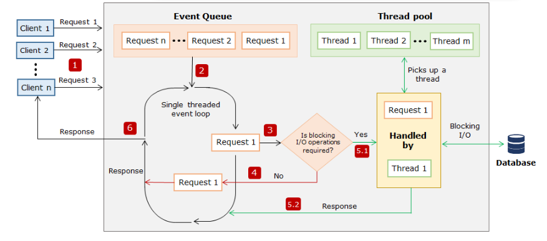
Single-threaded model with the event loop of Node.js

Slide 21
Single-threaded event loop model processing steps:
Step 1: Assume 'n' number of clients, send requests to the webserver to access the web application concurrently.
Node web server receives those requests and places them into a queue known as "Event Queue".
The Node web server internally maintains a limited thread pool to provide service to the client. Let us assume that 'm' number of threads can be created and maintained.
Step 2: The Node web server internally has a component, known as "Event Loop". It uses the indefinite loop to receive requests and process them. But the Event loop component uses a "Single Thread" to process the requests.

Slide 22
Step 3: The event Loop component checks for any client request that is placed in the Event Queue. If no requests are present, then it waits for incoming requests. If the requests are present, then it picks up one client request from the Event Queue and starts processing that request.
Step 4: If that client request does not require any blocking I/O operations, then the request is processed till completion and the response is sent back to the client.

Slide 23
Step 5.1: If the client request requires some blocking I/O operations like file operations, database interactions, any external services then it checks the availability of threads from the internal thread pool.
Step 5.2: One thread is assigned from the internal pool of threads and assigned to the client request. That thread is responsible for taking that request, processing it, and performing blocking I/O operations.
Step 6: After processing the request, the response is prepared and sends back to the Event Loop. Event Loop then sends that response back to the requested client.

Slide 24
5. Scalability
Scalability is that it makes use of event-driven programming with the Single Threaded Event Loop Mechanism. This enables the Node application to serve a huge number of incoming requests concurrently and it scales up automatically to serve those requests efficiently.
6. I/O bound operations
Due to its asynchronous/non-blocking nature, Node.js can be used to create I/O bound applications that involve huge input-output operations, such as creating real-time applications that have real-time data flowing in. Applications like Facebook, online chat applications, and Twitter are a few examples.
An online marketing company like eBay makes use of Node.js to handle lots of I/O-bound operations to handle eBay-specific services that display information on the page.

Slide 25
7. Streaming of data
Node.js has a built-in Stream API available, using which we can stream the data very fast. Applications like the Twitter stream, video stream, etc. use this feature.
Media companies like National Public Radio, Direct TV, HBO makes use of Node.js to stream the data to their viewers.
8. Modularity
Node.js supports modular JavaScript. Instead of writing code in a single JavaScript file, the code can be written in modules which can then be accessed at multiple places in the application. This helps in easy maintenance and reusability of the code.

Slide 26
Where to use Node.js and where not to?
If an application involves a lot of calculations that require CPU for processing, is not fit for Node.js.
Node.js shines well for applications that involve lots of I/O bound operations.

Slide 27
Node.js in the web application stack
Now let us take a look at the position of Node.js in the web application stack.
Node.js places itself in the server-side in the complete web application stack and provides a complete server-side solution for application development.
Node.js works well with any client-side technology like Angular, React, etc. and any database like MongoDB, MySQL, etc. can be used for data storage.

Slide 28
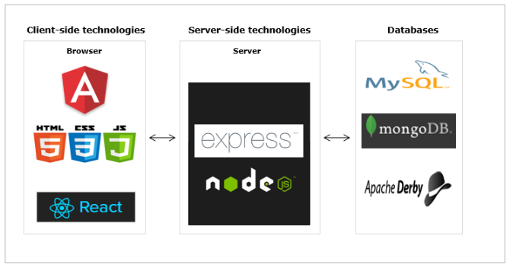

Slide 29
How to use Node.js
Download Node.js from the official site.
It is important to download the stable version while installing, as the Node.js team keeps upgrading the version by adding new features and enhancements.
To check whether Node.js is installed or not in your machine, open the Node command prompt and check the Node.js version by typing the following command.
node -v

Slide 30

The flag -v will display the version of Node.js installed in the machine.
Node.js also provides a package manager called NPM(Node Package Manager) which is a collection of all open-source JavaScript libraries. It helps in installing any library or module into your machine.
Thus we have successfully installed Node.js in the machine and we can start the application development using Node.js.

Slide 31
Highlights:
Creating a JavaScript file
Executing the JavaScript file using Node.js
Demo steps:
Now that we know how to install the Node.js platform in our machine, let us create our first Node.js program.
Step 1: Create a folder NodeJS in D drive and create a new JavaScript file, first.js inside the folder. Type the below code inside the JavaScript file.
console.log("My First Node.js program");

Slide 32
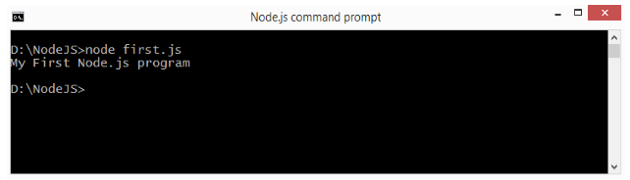
Step 2: Navigate to the created NodeJS folder in the NodeJS command prompt and execute the JavaScript file, first.js using the node command.
node first.js
Step 3: After the successful interpretation of the code, we can see the output in the Node.js command prompt.

Slide 33
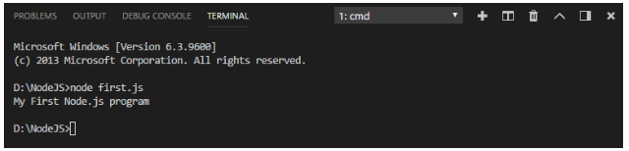
Visual Studio Code IDE
You can also open the NodeJS folder, in Visual Studio Code IDE. To execute the first.js file, open the integrated terminal and issue the command for executing the file. You will get the output as shown below:
Let us now see how to execute a JavaScript file that contains code for browser interaction through Node.js.

Slide 34
JavaScript code executable in Node.js
Let us make a small modification to the code written in the first.js created earlier.
document.write("My first Node.js program!");
We have replaced console.log() with document.write().
The document.write() function displays output on the browser screen. While interpreting the first.js using Node.js now, we will encounter an error as shown below:

Slide 35
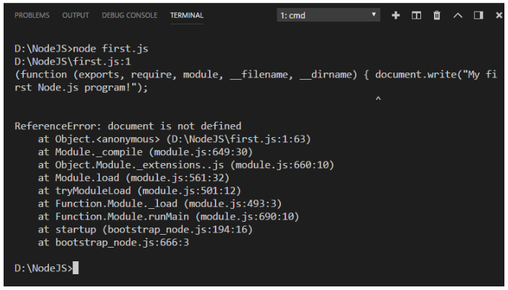
So, we can now conclude that any JavaScript file which doesn't contain codes for browser interactions will execute successfully using the Node platform.

Slide 36
Create web server in Node.js – Demo
Highlights:
Using require() and createServer() method
Running a web server in Node.js
Demosteps:
Step 1: Create a new JavaScript file httpserver.js and include the HTTP module.
const http = require("http");
Step 2: Use the createServer() method of the HTTP module to create a web server.
var server = http.createServer((req, res) => {
res.write("Hello World! I have created my first server!");
res.end();
});
server.listen(3000);
console.log("Server started... Running on localhost:3000");

Slide 37

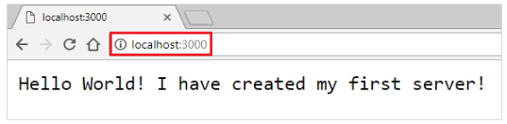
Step 3: Save the file and start the server using the node command. When the file executes successfully, we can observe the following output in the console.
Step 4: We will observe the following in the browser.
Thus we have created a Node server and sent the response from the server to the client.

Slide 38
Introduction to Node Package Manager
We saw the usage of one of the built-in modules in Node.js: HTTP module. There are many other built-in modules as well, provided by Node.js for implementing various functionalities.
It is also possible to import an external module into a Node application, using NPM (Node Package Manager).
What is NPM?
NPM stands for Node Package Manager which is a collection of all the open-source JavaScript libraries available in this world. It is the world’s largest software registry maintained by the Node.js team. There are many packages available on NPM which can be used in our application development.

Slide 39
The npm CLI
NPM provides a command-line interface "npm" to work with the NPM repository, which comes bundled with Node. This tool can be used to install, update, or uninstall any package through NPM.
How to get the packages to be installed in our application?
To install any NPM package use the below code in the command prompt:
npm install <package_name>[@<version>]
This will create a folder node_modules in the current directory and put all the packages related files inside it. Here @version is optional if you don't specify the version, the latest version of the module will be downloaded.
You can even get tools from NPM like @angular/cli, typescript (compiler), etc.
There are two modes of installation through NPM
Global
Local

Slide 40
Global installation
If we want to globally install any package or tool add -g to the command. On installing any package globally, that package gets added to the PATH so that we can run it from any location on the computer.
npm install -g <package_name>
Consider the scenario where "express" which is the most popular framework of Node to be used in our application. Then it can be installed using NPM as below.
npm install -g express
To install any package that is to be available from anywhere on the computer, then better to go for global installation.

Slide 41
Local installation
If we do not add -g to your command for installation, the modules get installed locally, within a node_modules folder under the root directory. This is the default mode, as well.
npm install express
To install any application-specific package, get it installed locally.
Best Practice Tip: Start all projects with npm init. This will create a new package.json for you which allows you to add a bunch of metadata to help others working on the project have the same setup as you.

Slide 42
How to update the packages in our application?
We can also update the packages downloaded from the registry to keep the code more secure and stable.
To update a locally installed package, navigate to the folder the package is installed and run the below command.
npm update
Any update for a global package can be done using the following command.
npm update -g <package_name>

Slide 43
How to uninstall the packages in our application?
We can uninstall the package or module, which we downloaded using the following command.
npm uninstall <package_name>[@<version>]
npm uninstall express@2.1.0
NPM Alternatives
NPM is one of the oldest package managers for Node.js. There are other replacements like YARN that works with the NPM registry.

Slide 44
What is package.json file?
A Node project needs a configuration file named "package.json". It is a file that contains basic information about the project like the package name, version as well as more information like dependencies which specifies the additional packages required for the project.
To create a package.json file, open the Node command prompt and type the below command.
npm init

Slide 45
Enter values for package name, version, description, and so on. This will generate a package.json file similar to the one shown below:
{ "name": "mypackage",
"version": "1.0.0",
"description": "\"Testing publishing\"",
"main": "index.js",
"scripts": {
"test": "echo \
"Error: no test specified\" && exit 1"
},
"author": "",
"license": "ISC“
}

Slide 46
The name and version represent the module name and the version to be used while publishing.
The description represents a brief description of the module.
The property main represents the entry point of the application.
The test represents all the test scripts to run.
The author represents the author's name and the license represents the license type of the module.

Slide 47
Publish custom module to NPM-Demo
The NPM repository has a collection of modules that we can download and use in our application.
It is also possible to publish the custom modules that we created to NPM so that we can make our modules to be available for others to download.
Let us understand how to publish a custom module to the NPM repository.
Steps to publish a custom module to NPM:
Step 1: Create a user account using the signup option in npmjs.com or using npm adduser command from the command prompt as below:
D:\>npm adduser

Slide 48
Step 2: Create a package.json file in a folder named mypackage.
Specify application configurations in this file.
{ "name": "mypackage",
"version": "1.0.0",
"description": "Testing publishing",
"main": "webServer.js",
"scripts": {
"test": "echo \"Error: no test specified\" && exit 1" },
"keywords": ["node” ],
"author": "",
"license": "ISC"}

Slide 49
Step 3: Create a module in the same folder inside which the package.json file resides.
MyModule.js
exports.myMethod = function () {
console.log('Method invoked from a module');
};
Create another file where MyModule is to be imported and invoke the myMethod() function.
TestModule.js
const myModule = require('./MyModule');
myModule.myMethod();
Step 4: Run the code using the Node command and test it.
D:\mypackage\>node TestModule.js

Slide 50
Step 5: Use npm publish command from the command prompt to publish the module to npm:
D:\mypackage\>npm publish + mypackage@1.0.1
The package will be published successfully. To use this module from npm, just use the "npm install mypackage" command from the command line and it will get installed.

Slide 51
Node Package Manager
Highlights:
Usage of NPM
Installing a module using NPM
Demo steps:
Step 1: Write the following statement in your terminal in order to install the express module using npm.
npm install -g express
Step 2: You can observe the following in your integrated terminal.
Thus express module will be installed in the machine. Similarly, any other module can be installed through the npm repository.

Slide 52
NPM audit
To perform a quick security check know, as a moment-in-time review of your application, we can make use of npm audit which generates a report on the dependencies of your application. This report consists of security threats to your application and can help you fix vulnerabilities by providing npm commands and recommendations for further troubleshooting.
Example:-
running npm audit against myApp:
cd myApp
npm audit

Slide 53
Modularizing Node application
In an Enterprise application, it is not possible to have all the logic written in a single file.
As the complexity of the program increases, it reduces the readability and maintainability of the application.
In this kind of environment, it is easy to lose track of what a particular code does or to produce reusable code.
So the application needs to be created in a modularized fashion.
What is modularization?
Modularization is a software design technique in which the functionality of a program is separated into independent modules, such that each module contains the desired functionality.

Slide 54
Advantages of Modularization
Readability: Modular code highly organizes the program based on its functionality. This allows the developers to understand what each piece of code does in the application.
Easier to debug: When debugging large programs, it is difficult to detect bugs. If a program is modular, then each module can be debugged easily by the programmer.
Reusable Code: Modular code allows programmers to easily reuse code to implement the same functionality in a different program.
Reliability: Modular code will be easier to read. Hence it will be easier to debug and maintain the code which ensures smoother execution with minimum errors.

Slide 55
Node environment provides many built-in modules that can be used in application development.
We have already seen the usage of the "HTTP" module, which is a built-in module in Node.js for creating a web server.
Node.js also provides many other useful modules like fs module (used for file-related operations), os module(used for operating system-related functions), net module( used for socket programming), etc. for server-side application development.
Let us explore how to modularize an application in Node.
How to modularize code?
Consider a simple Node.js application with a Javascript file calculator.js with the below code:

Slide 56
calculator.js
async function add(operator1, operator2)
{
return 'Result: ', operator1 + operator2;
}
async function substract(operator1, operator2)
{
return 'Result: ', operator1 - operator2;
}
async function asyncCall()
{
console.log('calling');
const result = await add(2, 3);
console.log(result);
}
asyncCall();

Slide 57
By default the functions declared in one module are visible only in that specific module.
In order to export the functionalities of one module into another, Node.js has provided an object called "exports".
This object is a built-in object of Node.js to which all the functionalities are to be attached.
We can assign the function reference to the exports object, which can be written as:

Slide 58
exports.add = async (operator1, operator2) => {
console.log("Result:", operator1 + operator2);
};
exports.subtract = async (operator1, operator2) => {
console.log("Result:", operator1 - operator2);
};
Now we have exported the functions in the calculator.js file, let us see how to import it in another file.

Slide 59
Importing a module
Let us now understand how to import the calculator.js file into another file.
Consider another file tester.js, where we need to import and use the functions in the calculator.js file. Use require() function and specify the module name to be imported as shown below:
const myCalculator = require("./Calculator");
The require() function takes the path of the file as a parameter and returns an exports object. Now in order to use the methods of calculator.js add the below code in the tester.js file:
myCalculator.add(10, 30);
myCalculator.substract(30, 10);

Slide 60
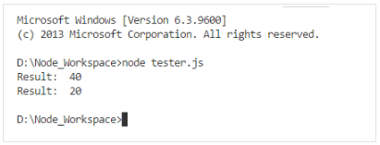
On executing the tester.js file, we will get the following output:

Slide 61
Creating a module in Node
Highlights:
Creating a module
Loading the module
Demosteps:
Step 1: Create a file DBModule.js within the NodeJS folder created earlier.
exports.authenticateUser = (username, password) => {
if (username === "admin" && password === "admin") { return "Valid User";
}
else return "Invalid User";
};

Slide 62
Step 2: Modify the file httpserver.js file created earlier as below.
app.js
const http = require("http");
var dbmodule = require("./DBModule");
var server = http.createServer((request, response) => {
result = dbmodule.authenticateUser("admin", "admin"); response.writeHead(200, { "Content-Type": "text/html" });
response.end("<html><body><h1>" + result + "</h1></body></html>");
console.log("Request received");});
server.listen(3000);
console.log("Server is running at port 3000");
In the httpserver.js file, we are loading the module "DBModule" and then invoking the function named "authenticateUser()".

Slide 63

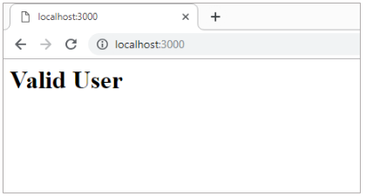
Step 3: Run the httpserver.js using the node command.
Open a browser and navigate to URL "http://localhost:3000" and observe the output.

Slide 64
Restarting Node Application
Whenever we are working on a Node.js application and we do any change in code after the application is started, we will be required to restart the Node process for changes to reflect.
In order to restart the server and to watch for any code changes automatically, we can use the Nodemon tool.
Nodemon: is a command-line utility that can be executed from the terminal.
It watches the application and whenever any change is detected, it restarts the application.
To install it in the application, run the below command.
npm install nodemon -g

Slide 65
Once the 'nodemon' is installed in the machine, the Node.js server code can be executed by replacing the command "node" with "nodemon".
nodemon app.js
Thus the 'nodemon' starts the application in watch mode and restart the application when any change is detected.

Slide 66
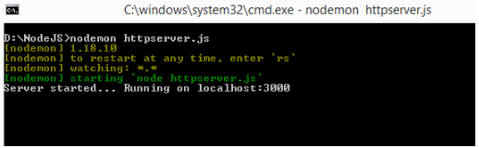
const http = require("http");
var server = http.createServer((req, res) => { res.write("Hello World! I have created my first server!"); res.end();
});
server.listen(3000);
console.log("Server started... Running on localhost:3000");
Observe the console on starting the nodemon in a command prompt window.

Slide 67
Now open the application code and do changes in the code as below.
const http = require("http");
var server = http.createServer((req, res) => { console.log("Request URL is " + req.url);
res.write("Hello World! I have created my first server!"); res.end();
});
server.listen(3000);
console.log("Server started... Running on localhost:3000");

Slide 68
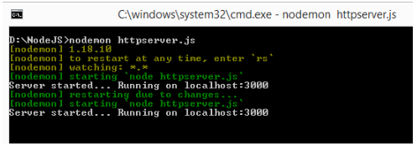
Observe the console message in the command prompt. Nodemon automatically restarted the server on observing changes in the code.
Best Practices Tip: To avoid over and over restarting of server for small changes to reflect. It is important to have an automatic restart of the server of your application. Use nodemon for this purpose.

Slide 69
Need for File system module
The user wants to store the information about the requested URLs to the application/errors that occurred in the application.
To store this information, the user can choose any of the following methodologies:
File
Database
Storing log details in the Database is not an optimal solution because it may increase the number of API calls for DB interaction. This will impact the performance of the application.
The best solution to use the file system, here. The information will be stored locally in the application without impacting the performance of the application.

Slide 70
fs Module
One of the important operations in server-side programming is to be able to read or write the content of a file.
Node.js comes with the file system (fs) module fs to perform file operations.
It provides many useful functionalities to interact with the file system.
How to use fs module?
To include the File System module, use the require() method:
const fs = require('fs');
Once imported, we can use different methods provided by this module for doing any file manipulations.

Slide 71
fs module – Operations
Some of the file operations are:
Writing data to a file
Reading data from a file
Updating content in a file
Writing data to a file:
The File System module has the following methods for creating a new file and writing data to that file:
writeFile()
appendFile()
The fs.writeFile() method will overwrite the content if the content already exists.

Slide 72
If the file does not exist, then a new file will be created with the specified name and content.
Syntax:
fs.writeFile(file, data, callback);
file: Placeholder to give the file name in which you are going to write the data.
data: The data/content must be written to the file.
callback: The callback method, that will be executed, when 'writeFile()' function is executed. This callback will be executed in both success as well as failure scenarios.

Slide 73
Writing data to a file – Async/Await
Method 1:
Before Node.js v8, If we want to avoid callbacks, we have to manually promisify the fs.writeFile function.
Let's manually promisify and wrap it in a function:
//Method 1 // promisifing writeFile method
const fs = require('fs');
const writeFilePromise = (file, data) => {
return new Promise((resolve, reject) => {
fs.writeFile(file, data, (err) => {
if (err)
reject('Could not write file');
resolve('success'); });
});
};

Slide 74
//Invoking the promise which we have created.
Self-invocation
function(async () => {
try {
await writeFilePromise('myData.txt', `Hey @ ${new Date()}`);
console.log('File created successfully with promisify and async/await!');
}
catch (err) {
console.log(err);
}
})();

Slide 75
Method 2:
In the latest versions of Node.js, 'util.promisify()' will allow us to convert I/O functions that return callbacks into I/O functions that return promises.
// Method 2
const fs = require('fs');
const { promisify } = require('util');
const writeFile = promisify(fs.writeFile);
(async () => {
try {
await writeFile('myData.txt', `Hey @ ${new Date()}`);
console.log('File created successfully with promisify and async/await!');
}
catch (err) { console.log(err); }
})();

Slide 76
Appending data to a file
The appendFile() method first checks if the file exists or not. If the file does not exist, then it creates a new file with the content, else it appends the given content to the existing file.
Syntax:
fs.appendFile(path, data, callback)
path: Placeholder to give the file name in which you are going to append the data.
data: The data/content which must be appended to the file.
callback: The callback method, that will be executed, when 'appendFile()' function is executed. This callback will be executed in both success as well as failure scenarios.

Slide 77
You might have an existing file from the previous demo, paste the below code in that file.
const fs = require('fs');
const { promisify } = require('util');
const appendFile = promisify(fs.appendFile);
(async () => {
try {
await appendFile('myData.txt', `\nHey @ ${new Date()}`);
console.log(
'File content appended successfully with promisify and async/await!'
);
} catch (err) {
console.log(err);
}
})();

Slide 78
Save the file and run the code using the node command. Open the myData.txt file, we can observe that the new log information has been appended to the file.
Try out some more: Delete the myData.txt file and re-run the code multiple times with various different inputs and observe.

Slide 79
Reading data from a file
The fs.readFile() method is used to read the content from a given file.
Syntax:
fs.readFile(path, encoding, callback);
path: Path where the file with data/content resides, with respect to the root folder.
encoding: an optional parameter that specifies the type of encoding to read the file. Possible encodings are 'ascii', 'utf8', and 'base64'. If no encoding is provided, the default is utf8.
callback: The callback method, that will be executed, when readFile() function is executed.

Slide 80
Consider the below sample code for reading data from a file "myData.txt".
const fs = require('fs');
const { promisify } = require('util');
const readFile = promisify(fs.readFile);
(async () => {
try {
const fileData = await readFile('myData.txt', 'utf8'); console.log(fileData);
}
catch (err) {
console.log(err);
}
})();

Slide 81
Demo: Writing data to a file
Highlights:
Usage of fs.writeFile() method
To 'write' data to a file
Step 1: Create a file fileSystem.js and paste the below code in the file.
const fs = require('fs');
const { promisify } = require('util');
const writeFile = promisify(fs.writeFile);
(async () => {
try {
await writeFile('myData.txt', `Hey @ ${new Date()}`);
console.log('File created successfully with promisify and async/await!');
}
catch (err) { console.log(err); }
})();

Slide 82


Step 2: Run the above code using node command 'node fileSystem.js' to see the output.
Step 3: Check in the folder in which "fileSystem" file resides. You can observe that a new file named myData.txt has been automatically created logging the string content and date.
Step 4: Provide different values in the data/content part of the writeFile() function and observe the ‘myData.txt' file.

Slide 83
Step 5: You might have observed that the file content is getting replaced with the latest data, whenever you run this code.
The writeFile() method has overwritten the previous content. To resolve this, we will use appendFile() method.

Slide 84
Demo - Appending data to a file
Highlights:
Usage of fs.appendFile() method
To append data to a file
Demosteps:
Step 1: Create a file log.js and paste the below code in the file.
The appendFile() method first checks if the file exists or not. If the file does not exist, then it creates a new file with the content, else it appends the given content to the existing file.

Slide 85
const fs = require('fs');
const { promisify } = require('util');
const appendFile = promisify(fs.appendFile);
(async () => {
try {
await appendFile('myLogger.txt', `Request received @ ${Date()} \n`);
console.log('File content appended successfully');
}
catch (err) { console.log(err);
}
})();

Slide 86
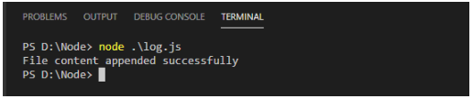
Step 2: Run the above code using node command 'node log.js' to see the output.
Now that we have learned about writing and appending data to a file, let us learn about reading data from a file.

Slide 87
Demo - Reading data from a file
Highlights:
Usage of fs.readFile() method to read the content of file.
Demosteps:
Step 1: Create a JavaScript file 'fileSystem.js' and add the below code:
const fs = require('fs');
const { promisify } = require('util');
const readFile = promisify(fs.readFile);
(async () => {
try {
const fileData = await readFile('demo.txt', 'utf8'); console.log(fileData);
}
catch (err) { console.log(err); }
})();

Slide 88
Step 2: Create a file demo.txt and add the following text.
Node.js is an open-source JavaScript run time environment which helps the developers to build fast, scalable network applications. Express is a very popular framework for Node.js, which simplifies the Node application development.
Step 3: Run the file 'fileSystem.js' and observe the output in the console.

Slide 89
THANK YOU

